Slide 1
Basic Helping Verbs in English

Slide 2
Helping verbs (Auxiliary verbs) don’t have a specific definition.
They “help” the main verb of the sentence.
In this lesson, you’ll learn the basic verbs “Do” “Be” and “Have”

Slide 3
Helping Verb 1- DO
To ask questions:
Do you like cake?
Does Joey have a pet?
Did you go to church?
Use “do” in the present tense with; I, we, you, they
Use “does” in the present tense with; she, he, it
Use “did” with all forms in the past.

Slide 4
Helping Verb 1- DO
Use “do” with question words:
Where do you work?
What time does the post office open?
Why did she go home early yesterday?

Slide 5
Helping Verb 1- DO
We also use “do” to form negative statements:
I don’t like cake.
Joey doesn’t have a pet.
We didn’t go to church.

Slide 6
Helping Verb 1- DO
Avoid this common error:
I no like cake. X
I not like cake. X
I don’t like cake. /

Slide 7
Helping Verb 2- BE
Form continuous tenses:
Present: am / is /are
I’m studying French.
He’s playing computer games.
We’re watching movie now.

Slide 8
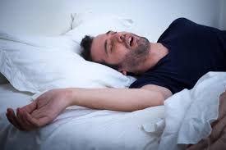
Helping Verb 2- BE
Form continuous tenses:
Past: Was / Were
He was sleeping while we were talking in the living room.

Slide 9
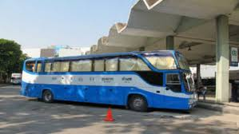
Helping Verb 2- BE
Form continuous tenses:
Future: Will Be
Tomorrow morning I’ll be travelling by bus in going to Singapore.

Slide 10
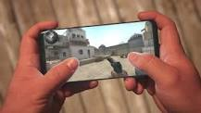
Helping Verb 2- BE
Questions: Word order
Is he playing on the phone?
He is playing on the phone.

Slide 11
Questions: Word order
Is he playing on the phone?
He is playing on the phone.
Were you having lunch?
We were having lunch.

Slide 12
Helping verb 3 - Have
Perfect tenses
Present perfect: have or has
I’ve finished my project.
She has just left for work.

Slide 13
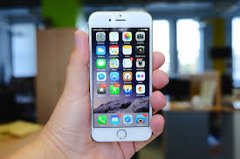
Helping verb 3 - Have
Past perfect- use had
He said he had bought an iPhone.
John had walked the dog before he fell asleep.

Slide 14
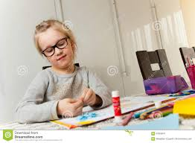
Helping verb 3 - Have
Future Perfect - use Will Have
By this time tomorrow, I will have finished this project.

Slide 15
Helping verb 3 - Have
Questions: Word order
Have you finished the work?
I have finished the work.

Slide 16
Helping verb 3 - Have
Questions: Word order
Has she left the clinic?
She has left the clinic.

Slide 17
Helping verb 3 - Have
Questions: Word order
Had he bought the iPhone?
He had bought the iPhone.

