Slide 1
Used + infinitive

Slide 2
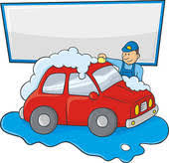
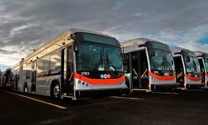
Past
Present
Joey used to work in a car wash. Now he works in a bus company.
used + infinitive this means;
= to describe a habit or regular action from the past.
= We do not have this habit or do the action in the present.

Slide 3
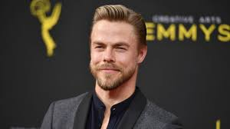
1. Affirmative form
This is Derek Hough. He is a famous ballroom dancer.
He used to dance in Dancing with the Stars.
Now he dances for his own show.
Subject + used + main verb
(past simple of “use”) (infinitive form)
I used to dance.
You used to dance.
He/she/it used to dance
We used to dance
You used to dance
They used to dance

Slide 4
2. Affirmative form
used + infinitive
This structure only has a past form.
I used to dance ballroom.
There is no infinitive form of use:
I am going to use to dance ballroom. X
There is no -ing form:
I am using to dance ballroom.
There is no present form:
I use to dance ballroom. X
If you want to describe a habit or regular action in the present, we use the present simple.
I dance ballroom every day.

Slide 5
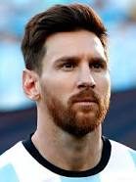
Negative Form
Lionel Messi did not use to play for Liverpool.
Subject + did not + “use” + verb
(base form) (infinitive form)
I did not use to play
You did not use to play
He/ she/ it did not use to play
We did not use to play
You did not use to play
They did not use to play

Slide 6
Contracted form (negative)
Full Form | Contracted form
I did not use to play | I didn’t use to play
You did not use to play | You didn’t use to play
He/ she/ it did not use to play | He/ she/ it didn’t use to play
We did not use to play | We didn’t use to play
You did not use to play | You didn’t use to play
They did not use to play | They didn’t use to play

Slide 7
Question Form
“Did you use to dance ballroom?”
Did + subject + use + verb ?
(base form ) (infinitive form)
Did I use to dance?
Did you use to dance?
Did he/ she/ it use to dance?
Did we use to dance?
Did you use to dance?
Did they use to dance?

Slide 8
Question Form 2
Where did they use to go on Saturday?
Why did you use to get up at 4:30 in the morning?
What did you use to eat for lunch?
The rule here is we have the words:
What
Why
Who
Where
How
+ did + subject + “use” + verb ?
(infinitive form)

Slide 9
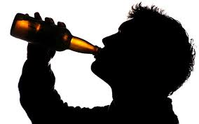
Habits in the past 1
Used + the infinitive
– to describe a habit or regular action that we had in the past.
We do not have this habit or do this action in the present.
For example:
In the past:
Dave used to drink alcohol.
In the present:
He no longer drinks alcohol.

Slide 10
Habits in the past 2
In the past:
Joey used to jog every evening.
In the present:
Joey watches TV every evening.

Slide 11
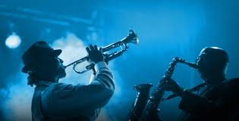
States in the past 1
Used + the infinitive
– to describe a state that we had in the past.
We do not have this state in the present.
For example:
In the past:
Rob used to like slow rock music.
In the present:
Now he likes jazz music.

Slide 12
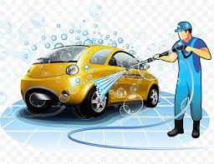
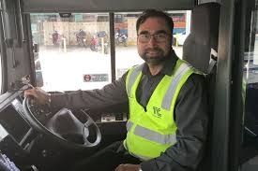
States in the past 2
In the past:
Rob used to be a car washer.
In the present:
Now he is a bus driver.

Slide 13
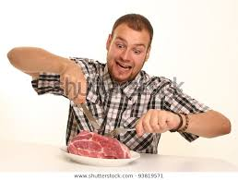
States in the past 3
Rob used to like beef steak.
Now he prefers fruit.
Past Present

Slide 14
Practice exercise 1
Complete the sentences with the positive, negative or question form of "used to" using the verb in brackets:
1. I ____________ (work) in the Twin Towers. 2. ____________ (leave) the classroom at 4 : 00 pm? 3. I ____________ (forgive) him. 4. He ____________ (beat) me. 5. The teacher ____________ (speak) English in the classroom. 6. He ____________ (write) a lot. 7. She ____________ (spend) time in the supermarket. 8. We ____________ (not / play) outside. 9. He ____________ (not /write) five stories a day. 10. ____________ (She / eat) three times a day?

