Slide 1
Nouns that only have a plural form

Slide 2
Certain English nouns only have a plural form.
The form is always plural. Never singular.
There are 3 types of nouns where the form is always plural:
1. Certain articles of clothing.
2. Certain tools or instruments.
3. Other types.
Let’s look at each type in detail.

Slide 3
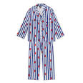
1. Certain articles of clothing
trousers
boxers
tights
pajamas
briefs
panties
shorts
jeans
I like your pajamas.
✓
Where are my boxers?
✓
I like your pajama.
X
Where are my boxer?
X
Where is my boxer?
X

Slide 4
2. Certain Tools or instruments
binoculars
scissors
glasses
headphones
sunglasses
Can I borrow your scissors?✓
Can I borrow your scissor? X
Where did you buy your binoculars?✓
Where did you buy your binocular? X

Slide 5
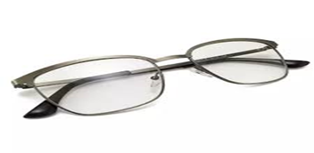
1. Certain articles of clothing 2. Certain tools and instruments
trousers pajamas sunglasses glasses
tights shorts binoculars scissors
jeans panties headphones tweezers
briefs boxers tongs pliers
We use the following structure for ONE unit (singular)
“pair of” + noun
I need a new pair of glasses.✓
I only have one pair of trousers.✓
I need a new pair of glass. X
I only have one trouser. X
I need a new glasses. X
I only have one trousers. X

Slide 6
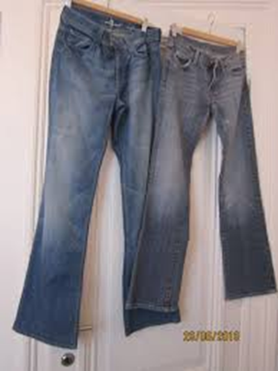
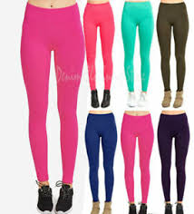
1. Certain articles of clothing 2. Certain tools and instruments
trousers pajamas sunglasses glasses
tights shorts binoculars scissors
jeans panties headphones tweezers
briefs boxers tongs pliers
We use the following structure for several units (plural)
“pairs of” + noun
I’d like to buy 2 pairs of jeans.✓
I’d like to buy 2 jeans. X
Here are lots of pairs of tights.

Slide 7
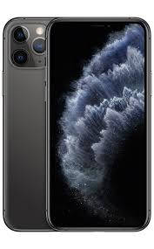
3. a. Other nouns with only a plural form
belongings
= personal things that belong to you. (hat, bag, scarf, glasses)
Don’t leave your belongings unattended.
savings
= money in your bank account
(You are saving the money for the future)
I spent my savings on a new iPhone.

Slide 8
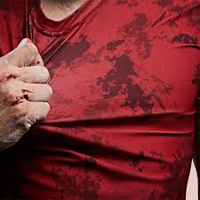
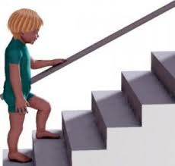
3. b. Other nouns with only a plural form
clothes
= general word for collection of articles of clothing
His clothes were covered in dirt.
stairs
Tim is going up the stairs

Slide 10
https//www.englishtutorhub.com

