Slide 1
Question tags Basic rules
EnglishTutorHub

Slide 2
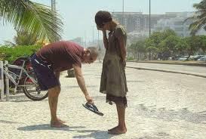
Question tags are short questions at the end of the sentence.
We use question tags in spoken English and in informal written English.
She’s lovely, isn’t she?
He’s kind, isn’t he?
You’re going to Spain tomorrow, aren’t you?

Slide 3
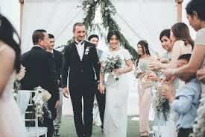
Meaning and use of question tags
1. to check if something is true.
The conference is at 8 o’clock, isn’t it?
2. to ask for agreement
It’s a beautiful wedding, isn’t it?

Slide 4
When to use question tags?
For an affirmative sentence, we use a negative question tag.
John can speak French, isn’t he?
They want to watch tennis match, don’t they?
For a negative sentence, we use the affirmative question tag.
John can’t speak French, is he?
They don’t want to watch tennis match, do they?

Slide 5
When NOT to use question tags
We do not use question tags at the end of a question.
Is the museum open today, isn’t it? X
Weren’t they doing their homework, were they? X

Slide 6
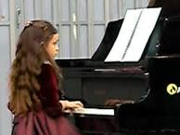
Form – rule 1
If the sentence has an auxiliary verb, we repeat it in the question tag:
Affirmative negative
Abby can play the piano, can’t she?
I should invite them, shouldn’t I?
Negative Affirmative
Mr. Cruz hasn’t finished his painting, has he?
Carl wasn't playing football in the garden, was he?

Slide 7
Form rule 2 – “be” as a main verb
If the sentence has “be” as a main verb we repeat it in the question tag:
Affirmative negative
John is kind, isn’t he?
The play was good, wasn’t it?
negative
Affirmative
He isn’t from Spain, is he?
We aren’t late, are we?

Slide 8
Form rule 3 – No auxiliary verb in the present simple
If the sentence has no auxiliary verb and is in the present simple, the question tag uses “do”:
Affirmative negative
You bake a cake, don’t you?
Pat likes to sing, doesn’t he?
Negative Affirmative
You don’t speak English, do you?
Helen doesn’t play the piano, does she?

Slide 9
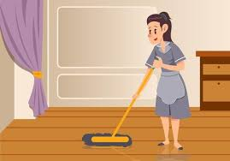
Form rule 4 – No auxiliary verb in the past simple
If the sentence has no auxiliary verb, and is in the past simple, the question tag uses ”did”
Affirmative Negative
He studied in Philippines, didn’t he?
Grace mopped the floor yesterday, didn’t she?
Negative Affirmative
Mr. Smith didn't come to the wedding, did he?
Pam didn’t want to go shopping, did she?

Slide 10
https//www.englishtutorhub.com

