Slide 1
“BOTHER”
Noun, verb and expression
EnglishTutorHub

Slide 2
bother /ˈbäT͟Hər/
In this lesson, you will learn how to use:
“bother” as a verb
“bother” as a noun
+
And a common expression with “bother”

Slide 3
“bother” as a verb
= to make an effort to do something
We usually use the negative form
= to not make an effort to do something
+ infinitive
bother
+ ING form
John never bothers to clean his room
John never bothers cleaning his room.
It was hot, so she didn’t bother to go out.
It was hot, so she didn’t bother going out.

Slide 4
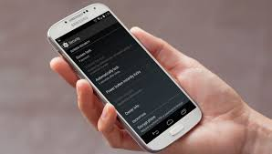
“bother” as a verb – more examples
Negative form:
= to not make an effort to do something
+ infinitive
bother
+ ING form
Don’t bother to call him. He’s busy.
Don’t bother calling him. He’s busy.
I’m not asking her because she won’t bother to answer.
I’m not asking her because she won’t bother answering.

Slide 5
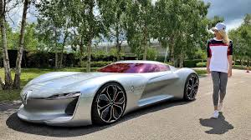
“bother” as a “verb” (2)
“bother someone” (transitive)
= A situation that makes someone feel worried or upset.
Anna’s final exam bothers her.
Not having a car doesn’t bother me.

Slide 6
“bother” as a verb (3)
bother someone (transitive)
= to annoy or cause problems for someone
I didn’t sleep last night because the mosquitos bothered me.
It bothered my father when my brother didn’t come home.

Slide 7
“bother” as a noun
(uncountable)
= trouble or problems
Doing homework every day is a bother.
John: Could you help me print these documents?
Dan: Of course! That’s no bother.

Slide 8
Expression with “bother”
We can form an adjective from the verb “bother”
bother - bothered
+ infinitive
Can’t be bothered
+ING form
= too lazy or too tired of doing something
I can’t be bothered to mop the floor.
I can’t be bothered mopping the floor.
She can’t be bothered to do her project.
She can’t be bothered doing her project.

Slide 9
visit englishtutorhub.com
Please Subscribe
Thank you!..

