Slide 1
Phrasal verbs with “over”
EnglishTutorHub

Slide 2
Phrasal verbs have 2 parts: verb + preposition
Example: tear up
The meaning of a phrasal verb is sometimes different from the meaning of the verb and preposition separately.
Verb: ”tear”(past simple: tore past participle: tore)
Meaning: To rip or to separate forcefully.
Example: John tore the paper.
Preposition: “up” Meaning: in a higher position
Phrasal verb: tear up
Meaning: to damage, remove or destroy something such as a piece of paper or cloth by pulling it into pieces.
My brother tore up all the pieces of paper on the table.

Slide 3
In this lesson, you will learn 5 phrasal verbs with the preposition “over”.
Pull over
Get over something
Fall over
Take over
Think something over
+
An expression with over as a prefix.

Slide 4
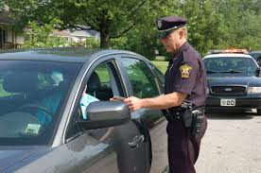
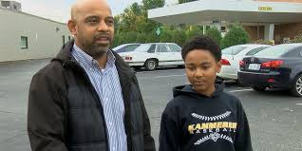
pull over
“pull over” is something we do in a car or vehicle.
It means to stop the car or vehicle at the side of the road.
The policeman signaled the driver to pull over.
. My father decided to pull over to have some drink.

Slide 5
Get over something
(past simple and past participle: got)
Meaning 1- to feel better physically or recover after an illness.
Tim: How are you?
Helen: I have a sore throat but I’m getting over it.
Meaning 2 – to feel better mentally after being sad or upset.
It took Peter a long time to get over the loss of his grandmother.
My father finds out a good way to get over our present situation.

Slide 6
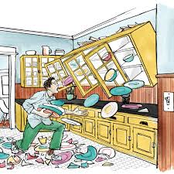
Fall over
past simple: “fell” past participle: “fallen”
Meaning 1: If a person “falls over”, he / she falls to the ground.
I saw an old lady fell over when she gets off the bus.
Meaning 2: If a thing “falls over”, it falls onto one side.
The cupboard looks as if its about to fall over.

Slide 7
Take over
past simple: took past participle: taken
= to replace someone
= to continue doing something for someone else
John has been selected to take over as manager when Mr. Cruz retires.
My father wants my eldest brother to take over the business.

Slide 8
Think something over
past simple: thought past participle: thought
= to consider something
= to think carefully about something before making a decision.
I’ll think over the position you offer and give you my answer tomorrow.
My father said, let’s think over what we would do this weekend.

Slide 9
Overcome
“overcome” is a verb with “over” as a prefix
past simple: “overcame” past participle: overcame
= to defeat something
= to succeed in controlling something.
Robert had to overcome a lot of struggles to finish his studies.

Slide 10
https//www.englishtutorhub.com
Please subscribe to this channel

