Slide 1
Would rather
EnglishTutorHub

Slide 2
We use “would rather” to describe a preference of one thing compared to another thing.
Mark would rather watch a football match than play computer games.
He would rather be a lawyer than be an architect.

Slide 3
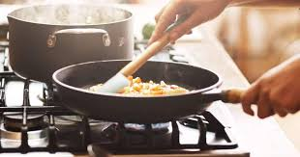
Would rather – affirmative full form
I would rather cook than bake.
Subject + “would rather” + base form + than + base form
I would rather cook than bake.
You would rather cook than bake.
He would rather cook than bake.
She would rather cook than bake.
It would rather cook than bake.
We would rather cook than bake.
You would rather cook than bake.
They would rather cook than bake.

Slide 4
Would rather – contracted form
I would rather cook than bake.
I’d rather cook than bake.
Subject + “’d rather” + base form + than + base form
I would rather cook than bake.
I’d rather cook than bake.
You would rather cook than bake.
You’d rather cook than bake.
He would rather cook than bake.
He’d rather cook than bake.
She would rather cook than bake.
She’d rather cook than bake.
It would rather cook than bake.
It’d rather cook than bake.
We would rather cook than bake.
We’d rather cook than bake.
You would rather cook than bake.
You’d rather cook than bake.
They would rather cook than bake.
They’d rather cook than bake.

Slide 5
Would rather – negative form
I would rather not bake.
Subject + would rather + “not” + base form
I would rather not bake.
You would rather not bake.
He would rather not bake.
She would rather not bake.
It would rather not bake.
We would rather not bake.
You would rather not bake.
They would rather not bake.

Slide 6
Would rather – affirmative form with 2 different subjects
If there are two different subjects in the sentence, the form is very different:
Subject + would rather + different subject + past simple
I would rather they slept here.
You would rather they slept here.
He would rather they slept here.
She would rather they slept here.
It would rather they slept here.
We would rather they slept here.
You would rather they slept here.
They would rather I slept here.
The form is the past simple but we are referring to the present or future.

Slide 7
Would rather – negative form with 2 different subjects
Subject + “would rather” + different subject + negative past simple form
I would rather they didn’t sleep here.
You would rather they didn’t sleep here.
He would rather they didn’t sleep here.
She would rather they didn’t sleep here.
It would rather they didn’t sleep here.
We would rather they didn’t sleep here.
You would rather they didn’t sleep here.
They would rather I didn’t sleep here.
The form is the past simple but we are referring to the present or future.

Slide 8
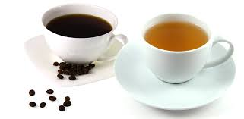
More examples - 1 subject
Would you like to drink coffee or would you rather want a cup of tea?
I would rather want a cup of tea.
I would rather not drink coffee.
I hate motorcycles. I would rather get the bus.
2 different subjects
I would rather you studied before playing computer games.
Kim would rather you didn’t write him an email.
I hate taxis. I would rather we got the bus.
Dave: I’ll come after lunch.
Tim: I’d rather you came before lunch.

Slide 9
Visit englishtutorhub.com
Please subscribe
and
hit the notification bell!..
Thank you!..
EnglishTutorHub

