Slide 1
“suppose” and “supposed to”

Slide 2
Suppose is a verb.
/suh·powz/
In this lesson you will learn:
2 uses of "suppose" as a verb
How to use "suppose to" in a short answer
Polite requests with "suppose"
"suppose" in the imperative
The structure "be supposed to"

Slide 3
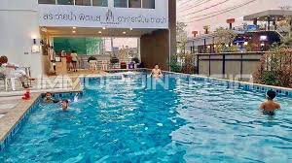
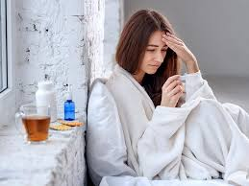
“suppose” as verb – use 1
So, the structure is: suppose + that clause
Meaning: think / believe / imagine that something is probably true.
Use: to explain the probable reason why something happened.
Why Tom doesn’t want to go swimming?
I suppose that he is tired.
Why didn’t Helen report to the office yesterday?
I suppose she wasn’t feeling well.

Slide 4
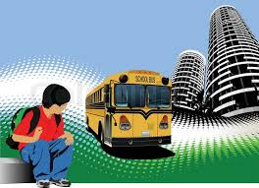
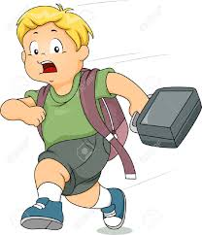
“suppose” as verb – use 2
suppose + that clause
Meaning: think / believe / imagine that something is probably true.
Use: When we are annoyed, or frustrated about something
Mother: Mark isn’t home yet so I suppose
his bus was delayed.
Teacher: I suppose that you wake up late again!

Slide 5
How to use “suppose” in a short answer.
“I suppose so”.
Meaning and use: to agree reluctantly or to say ‘yes’ reluctantly.
Tom: Can I play football?
Mom: I suppose so.
Kevin: Tom and Jerry are very funny. Did you like it?
Dan: I suppose so.
Emily: Can we take the bus?
Juvy: Yes, I suppose so.

Slide 6
Polite requests with “suppose”
We use the negative form of “suppose” to make a polite request.
“I don’t suppose that…?
“I don’t suppose that I could borrow your phone?”
I don’t suppose you could take me at the train station?
“I don’t suppose you could help me do my project?”

Slide 7
Suppose in the imperative
We use “suppose” in the imperative at the beginning of a sentence.
The meaning is “what if”
We often use this to make a suggestion.
Suppose we go for a drink a bottle of beer?
Suppose we eat lunch at the restaurant?
We use suppose + past tense if we are less certain about the plans.
Suppose we took a train?
Suppose we stood at the mall and waited him there together?

Slide 8
The structure “be supposed to”
be ‘supposed to’ + base form
/səˈpəʊsd/ /
Use and meaning: to describe obligations and arrangements.
Why are you here? You are supposed to go to school today.
You were supposed to picked me yesterday!
You are supposed to talk to the manager.

Slide 9
The structure “be supposed to” (2)
“be supposed to” also describes beliefs and expectations
be ‘supposed to’ + base form
/səˈpəʊsd/ /
The new car is supposed to be very good.
I’m going to Australia tomorrow. It’s supposed to be beautiful.
Diane is supposed to be the best student in class.

Slide 10
Visit englsihtutorhub.com
Please subscribe, Share and Like!..
Thank you!..

