Slide 1
“look forward to”

Slide 2
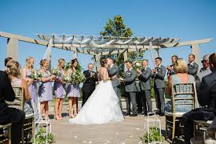
look forward to
= to think about something in the future with pleasure
= to be pleased or excited that something is going to happen
I’m looking forward to the wedding.
Let’s look at the grammar rules and some more examples.

Slide 3
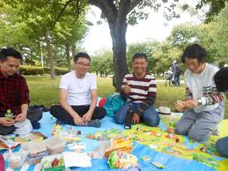
Form (1)
look forward to + noun phrase
Mike is looking forward to the picnic.
Bob is looking forward to his birthday.
I’m looking forward to the weekend.

Slide 4
Form (2)
look forward to + ing form
David is looking forward to buying a car.
I’m looking forward to going to Germany.
I’m looking forward to seeing you.
We do not use the infinitive / base form of the verb:
David is looking forward to buy a house. X
I’m looking forward to go to Germany. X
I’m looking forward to see you. X

Slide 5
Form (3)
If the second verb has a different subject, we use the object pronoun:
Context:
Keith is visiting me next week.
I’m excited about it.
I’m looking forward to him visiting me next week. /
We do not use the subject pronoun:
I’m looking forward to he visiting me next week. X

Slide 6
Very common in written English
“look forward to” is very common in written English.
We often use it at the end of a letter or email.
It’s a polite way of telling someone to do something.
We use the present simple form.
I’ll look forward to your reply.
Looking forward to hearing from you soon.
We look forward to receiving the contract.

Slide 7
http//www.englishtutorhub.com

