Slide 1
Articles A, AN, THE |
English Grammar for Grade 3

Slide 2
Presentation
1. Read the text given below.
Pay attention to the highlighted words as you read.
I met a girl on my way to school.
The girl had an orange and a pear with her.
She gave the orange to me. She ate the pear.

Slide 3
2. Look again at the sentences above.
Did you notice that we use a or an with the singular nouns?
Why do you think we use the with the same nouns again?
a girl
the girl
a pear
the pear
an orange
the orange

Slide 4
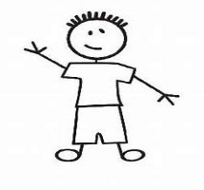
a an the
We use a before singular nouns beginning with a consonant sound.
a girl
a chair
We use an before singular nouns beginning with a vowel sound.
an orange
an ostrich

Slide 5
We use a or an when we mention a singular countable noun for the first time.
We use the when we repeat the noun.
I met a girl.
The girl was going to school.

Slide 6
https//www.englishtutorhub.com
Please subscribe to this channel…
THANK YOU

