Slide 1
Help our planet!| English Lesson

Slide 2
In this video you’re going to;
A. Listen, point and repeat.
B. Read, listen and match.
C. Ask and answer.

Slide 3
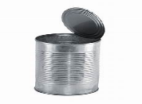
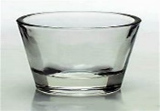
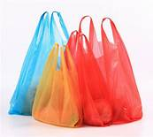
A. Listen, point and repeat.
Word Box
newspaper
can
paper
bottles
glass
rubbish
plastic bag
bin
recycle

Slide 4
B. Read, listen and match.
A
B
1. We read them.
a. bottles
2. we write on this. It’s in your
notebook.
b. bins
3. We put rubbish in them.
c. cans
4. They can be plastic or glass.
d. newspapers
We buy water and other drinks in them.
5. They are from the market. We put our
shopping in them.
e. paper
6. They are meal. They are used for food
and drink.
f. plastic bags

Slide 5
C. Ask and answer.
What do you do to save our planet?
I recycle glass
bottles.
I put rubbish in the bin

Slide 6
https//www.englishtutorhub.com
Please subscribe to this channel…
THANK YOU

