Slide 1
Punctuation Lesson | The Comma

Slide 2
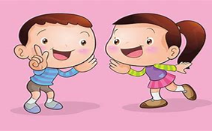
Presentation
A. Read the conversation
a. What have you got in your bag?
b. I have got a family photo, Kent.
a. Oh, that’s great!
b. These are my parents, brother, myself
and baby sister.
a. Yes, you all looked happy.

Slide 3
B. What is the function of a comma (,)?
C. Discussion
We use the full stop (.) to mark the end of a statement.
We use the question mark (?) to mark the end of a question.

Slide 4
Where to use the comma (,) #1
We use the comma;
-to separate words or items in a list or series.
Example:
There were monkeys, camels, pandas, birds and horses.
(We use and before the last item.)

Slide 5
Where to use the comma (,) #2
We use the comma;
-to separate the person or people you address.
Example:
Rosie, what have you got in your bag?
Come here, girls.

Slide 6
https//www.englishtutorhub.com
Please subscribe to this channel…
THANK YOU

