Slide 1
MY BEST FRIEND
Reading short stories

Slide 2
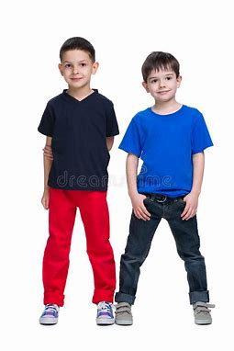
MY BEST FRIEND
Jason is my best friend.
He is 8 years old.
He is taller than me.
We go to the same school.
We both love playing basketball together.
It’s so much fun being with my friend.

Slide 3
Questions:
1. What is my best friend’s name?
a. Dan
b. Rob
c. Jason
2. How old is Jason
a. nine
b. eight
c. five

Slide 4
3. Which sports do we play together?
a. Volleyball
b. Badminton
c. basketball
4. Is Jason shorter than me?
a. Yes
b. No

Slide 5
https//www.englishtutorhub.com
Please subscribe to this channel…
THANK YOU

