Slide 1
Verbs and adverbs |
Parts of Speech in English Grammar

Slide 2
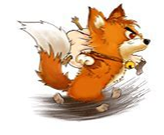
Presentation
A. Here is a poem for you to read.
The Fox
The fox runs quickly.
The fox runs quickly, unwillingly.
The fox runs quickly, unwillingly, hastily, blindly.
When it sees a snake appear unexpectedly.

Slide 3
B. What does the fox do?
How does it do it?
Verbs tell us of something being done -
To eat,
run,
fight,
wash
or play.
How things are done,
the adverbs tell –
As slowly,
swiftly,
hurriedly
or well!

Slide 4
A verb is a doing word. It shows the action.
The fox runs.
We cook food.
An adverb tells us more about the verb.
It tells us how the action takes place.
runs quickly
appear unexpectedly

Slide 5
An adverb tells us:
how the action takes place
slowly, boldly, blindly
when the action takes place
yesterday, now, lately
where the action takes place
here, inside, there

Slide 6
https//www.englishtutorhub.com
Please subscribe to this channel…
THANK YOU

