Slide 1
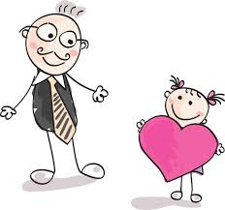
Thank you and thanks
English lesson

Slide 2
Here is today’s lesson plan:
“thank you” and thanks
Informal speech
“thank you” as a noun
“thank you” as a verb
2 common expressions

Slide 3
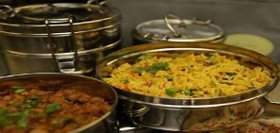
“thank you” and thanks
We say “thank you” or thanks to show that we are grateful for something.
Receptionist: Here is your key, Sir.
Dave: Thank you.
“thanks” is more informal than “thank you”
Joe: I prepared lunch for us. It’s ready.
Rose: Thanks.

Slide 4
If we are very grateful for something, we can say:
Thank you very much. ✓
Thanks very much.✓
Thank you so much. ✓
Thanks so much. ✓
Thank you a lot. ×
Thanks a lot. ✓

Slide 5
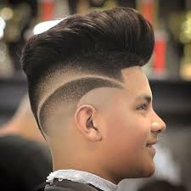
Examples of use
We say “thank you” or “thanks” when someone asks how we are.
John: Hi Jude. How are you?
Jude: Hello John, I’m good. Thanks.
We use “thank you” or “thanks” to reply to a compliment.
Anne: I like your new hairstyle.
Paul: Thank you very much.
Mary: I like your dress.
Eve: Thanks.

Slide 6
Polite Refusals
We say “thank you” or “thanks” to politely refuse something.
Jake: Another piece of pizza?
Joey: No thanks, I’ve eaten too much already.
Tom: We’re going out for lunch. Do you want to join us?
Ryan: No, thank you.

Slide 7
Very Informal Speech
In very informal language we can say “cheers”
Robert has not finished his project that’s due the next day.
James: If you need a hand, tell me.
Robert: Cheers!

Slide 8
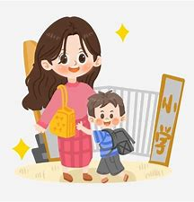
ING form
To say thank you for an action from the past or present, we use this structure:
“thank you”
or
+ for + ING form
“thanks”
Thank you for taking me to school.
Thanks for liking my fb page.

Slide 9
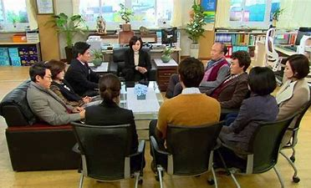
“thank you” as a noun
We can also use thank you as a noun.
Principal: I would like to give a big thank you to the faculty and staff for the job well done.

Slide 10
“thank” as a verb
We can also use “thank” as a verb.
I thank my friends for coming by.
Dan thanked his cousin for giving him a lift yesterday.

Slide 11
Common expression (1)
“thank God”
We say “thank God” to express relief about something.
We say “thank God” when we are pleased that something happened that we were worried about.
We have lost everything during the hurricane, but thank God we are safe.
I lost my wallet along the way, thank God I found it.
At last, the semester is over! Thank God.

Slide 12
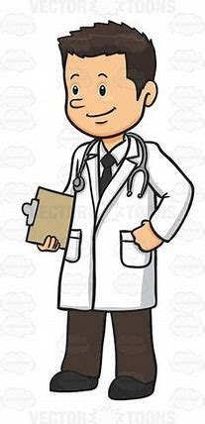
Common expression (2)
“thanks to” + noun phrase
“thanks to” means “because of”
It is common in written English.
My daughter is doing well in English subject, thanks to the effort of the teacher.
Thanks to my parents who supported me, I am a doctor now.

Slide 13
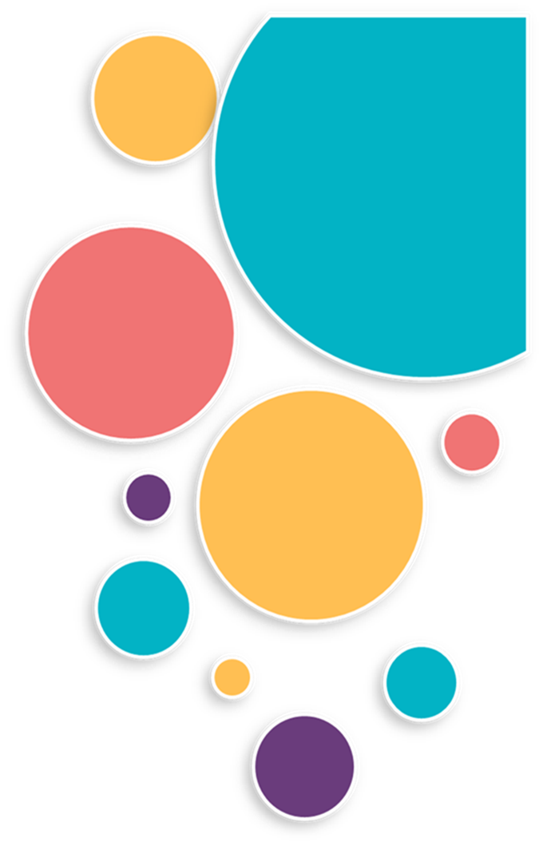
https//www.englishtutorhub.com
Please subscribe to this channel…
THANK YOU

