Slide 1
Final Consonant Sound /f/ as in calf

Slide 2
In this video,
you'll learn the final consonant
sound /f/ correctly

Slide 3
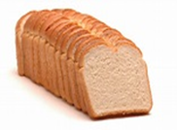
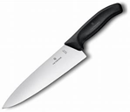
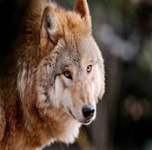
Look at the pictures.
Say the name of each picture and listen to the ending sound.
loaf
roof
knife
chef
Shelf
wolf
Ff
pronounced as /f/
is
as in fish,
playful
and elf.

Slide 4
Activity 1
Circle the correct word for each picture.
Then write the names of the picture in your notebook.
1.
leaf
half
cliff
2.
beef
sniff
chef
3.
loaf
half
stiff
4.
leaf
cliff
beef
5.
cliff
sniff
chief

Slide 5
https//www.englishtutorhub.com
Please subscribe to this channel…
THANK YOU

