Slide 1
Taking Care of Yourself

Slide 2
It is important for children to learn to take care of
themselves in order to keep their bodies healthy and strong.
Students will become more aware of the many things we do
to take care of ourselves and know that eating well is essential
if you want to stay healthy.

Slide 3
Taking Care of Yourself
Listen and Repeat
headache
earache
shoulder
have a shower
careful
painful
happen
better
pain
guess
well
make a loud noise
get up
watch tv
medicine
fever
tablet
eat well
terrible
sickness
food

Slide 4
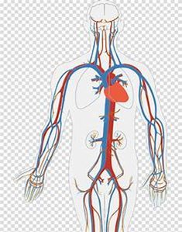
Taking Care of Yourself
heart
kidney

Slide 5
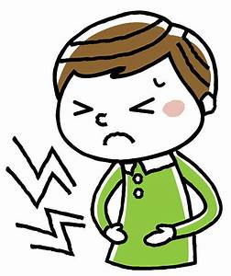
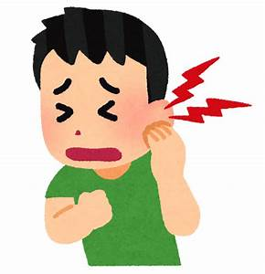
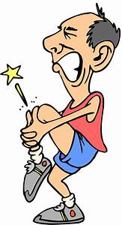
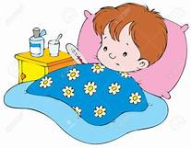
Taking Care of Yourself
stomachache
earache
pain,
painful
sick,
sickness
medicine
tablets

Slide 6
If you want your body to be healthy.
You must, look after it.
keep it clean

Slide 7
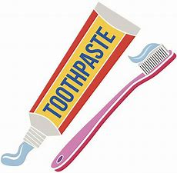
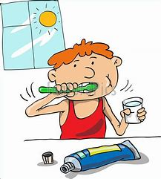
You have to use a
toothbrush and toothpaste
to brush your teeth.

Slide 8
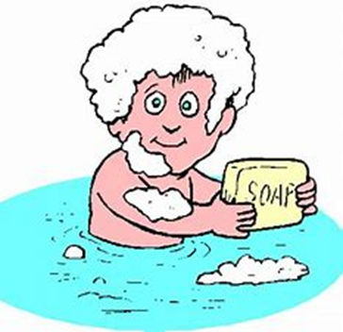
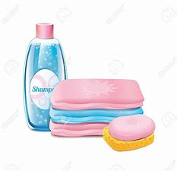
Use
to clean and wipe your body.
soap and towel
soap and towel

Slide 9
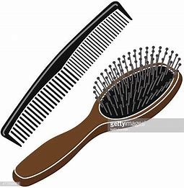
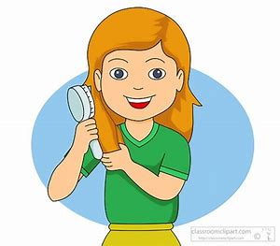
Use a
hairbrush / comb
to comb your hair.
hairbrush and comb
comb your hair

Slide 10
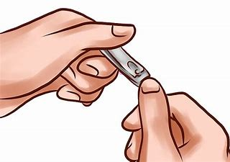
Use a
nail cutter
to cut your nails
and keep them clean.
nail cutter
cut your nails

Slide 11
Take care
of your eyes
by reading in proper light.

Slide 12
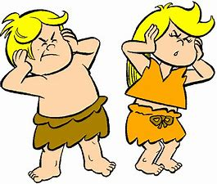
Stay away from
loud noises
to take care of your ears.
take care of your ears

Slide 13
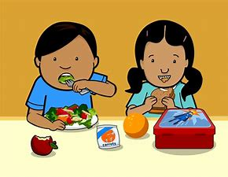
Take care of your stomach by
eating the right amount of food

Slide 14
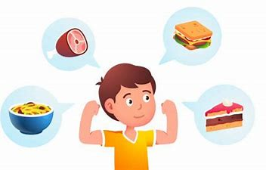
Body needs
good and clean food at regular interval
good food helps us grow and makes our body strong

Slide 15
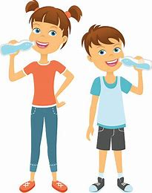
drinking clean water at a regular interval during the day is very important

Slide 16
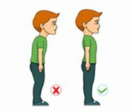
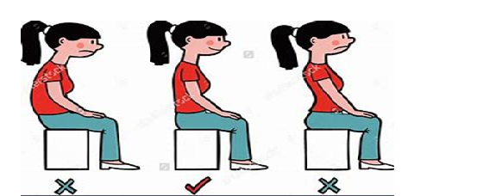
Maintain a correct posture is very important too,
you must always walk erect with your shoulders, neck and hand straight

Slide 17
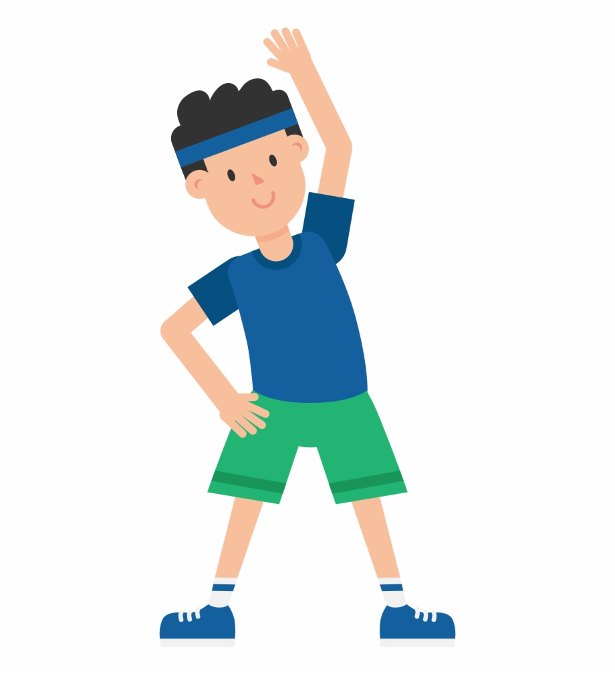
sleep is also very important as our body needs rest
regular exercise is also very important

Slide 18
So what did we learn?
We should take care of our body
We should keep it neat and clean
We should eat good food and exercise regularly to live a healthy life.

Slide 19
https//www.englishtutorhub.com
Please subscribe to this channel…
THANK YOU

