Slide 1
Match the following sentences | Activities

Slide 2
Match the following by writing the letter of the correct answer before each number in column A from column B.
Activity 1
A
B
______ 1. May I help you?
a. No more, thanks. /
That’s all thanks.
______ 2. What size do you want?
b. Thank you, sir. Here is forty-baht change.
______ 3. And the color?
c. Yes, I’d like to buy a shirt.
______ 4. Anything else?
d. Medium. (Size M)
______ 5. How much does it cost?
e. Green
______ 6. Here’s two hundred baht.
d. One hundred sixty baht.

Slide 3
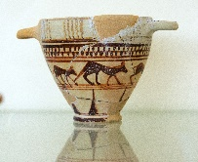
Activity 2
Where can you find the following items?
Women’s Clothing Department
____1. boots
b. Men’s Clothing Department
____6. skirts
c
a
c. Shoe Department
d. Jewelry Department
____2. necklace
f
d
e. Supermarket
____5. sofa
f. Furniture Department
b
e
____3. neckties
____4. sugar

Slide 4
https//www.englishtutorhub.com
Please subscribe to this channel…
THANK YOU

